Slide 1
MANAGING SPONSOR RESPONSIBILITIES FOR FEDERALLY-FUNDED RESEARCH Presented by the Research Quality Compliance Network

Slide 2
PRESENTERS
Ginger Bair, CCRP – QA/QC Coordinator, Office of Quality Compliance and CTSI
Josh Fessel, MD, PhD – Senior Clinical Advisor, Division of Clinical Innovation, NCATS and NIH
Panel:
Todd Bjorklund, MPC, BA – Office of Sponsored Projects (OSP)
Dholani Perera, BS, CCRP – Clinical Research Support Office (CRSO)
Dixie Thompson, BSN, RN – Clinical Research Unit (CRU)

Slide 3
learning objectives / agenda
Identify common funding mechanisms for research studies / trials – Ginger
Identify the roles necessary to complete a research study / trial and the definition of a Sponsor-investigator – Ginger
Explain the Good Clinical Practice (GCP) requirements of the Sponsor – Ginger
Discuss who is responsible to meet the GCP and regulatory requirements of the Sponsor in Investigator-initiated trials (IITs) and Federally Funded research (FFr) – Josh
Explain the offices and resources at the UofU that support IIT and FFr PIs meet the Sponsor responsibilities – Panel

Slide 4
Research funding mechanisms
Industry or Pharma – pharmaceutical companies such as Johnson & Johnson, Pfizer, Novartis, AstraZeneca, etc.
These are managed by a contract between the company and the Institution and a protocol
Federal – NIH, NSF, DOD, DOE
These are managed by a grant and notice of award between the federal agency and the institution.
These can fund an individual PI (such as an ROI), an office or institute at a University (such as the CTSI), or they can be a cooperative agreement where the same federally funded trial is run at several institutions.
Notes:
Ask the audience by raise of hand:
who has worked on a research study funded by a pharmaceutical company? (aka Industry funded)
who has worked on a research study funded by the NIH or DOD or NSF? (aka Federally funded)
who has worked on a research study funded by the PI or the Institution? (aka IIT)

Slide 5
Research funding mechanisms (cont.)
Institutional – these are usually called IITs, investigator-initiated trials and the primary funding is internal from the institution. A pharmaceutical company may provide support such as the drug, device, or supplies, but they are not the primary funder.
Private – these can be private non-profit organizations such as the American Heart Association, the Bill & Melinda Gates Foundation, etc

Slide 6
Roles in clinical research / trials
Sponsor: the person or entity that takes responsibility for the initiation, management, and/or financing of a clinical trial.
Investigator: the person responsible for conducting the research at a specific location(s).
Clinical Research Organization (CRO): a company hired by the sponsor and then delegated by the sponsor with certain tasks to perform. These tasks are the sponsor’s responsibility to perform and the sponsor is usually held accountable if these tasks are not performed in accordance with policies and regulations
Funder: a person or entity separate from the Investigator who provides funds or resources (sometimes even the investigational drug or device) for the research. This role is also usually held by the Sponsor but in the case of Sponsor-Investigator research, they are separate.

Slide 7
What is a sponsor-investigator
The University of Utah IRB’s definition of a sponsor-investigator is “An individual who both initiates and conducts - alone or with others - a clinical investigation. Corporations, agencies, or other institutions do not qualify as Sponsor-Investigators.”
The term, as defined in FDA regulations, does not include any entity other than an individual.
As the name suggests, a sponsor-investigator assumes the responsibilities of, and must comply with, Federal regulations applicable to both a sponsor and an investigator.
Sponsor responsibilities can be found in 21CFR312.50 (812 for devices) and section five of ICH GCP E6(R2).

Slide 8
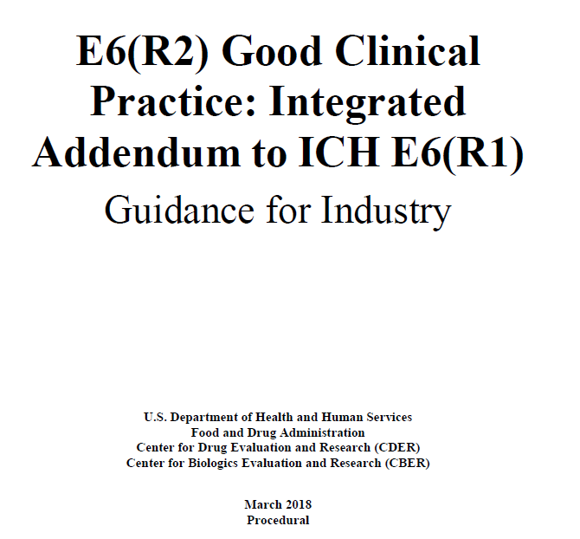
Gcp requirements of the sponsor
https://www.fda.gov/media/93884/download

Slide 9
Gcp: sponsor-investigator
University institutions have created excellent resources and the infrastructure for Principal Investigators (PIs) and research study teams to receive training in Good Clinical Practice (GCP). As would be expected, this training focuses on section four of the GCP Guidelines, the role of the Investigator. However, when a PI is conducting Sponsor-Investigator research (aka an Investigator-Initiated trial (IIT)), the PI also needs to be aware of and understand the regulatory requirements for a Sponsor. To a degree, this is also true for Federally funded research even though these types of studies/trials are not technically Sponsor-Investigator research.

Slide 10
Gcp examples section 5 – sponsor
Ensure quality management through the life of the study
Protocol development
Risk management
Ensure monitoring systems are in place
Appoint appropriately qualified personnel
Ensure protocol compliance
Regulatory approval and reporting requirements
Oversee regulation of the investigational product (IP)
Adequately train all study personnel, participants, and document their roles

Slide 11
references
https://database.ich.org/sites/default/files/E6_R2_Addendum.pdf
https://database.ich.org/sites/default/files/E6_R2_Step_4_Presentation_0.pdf
https://www.fda.gov/media/93884/download
https://www.fda.gov/about-fda/center-drug-evaluation-and-research-cder/good-clinical-practice
https://www.fda.gov/science-research/clinical-trials-and-human-subject-protection/regulations-good-clinical- practice-and-clinical-trials
https://www.fda.gov/industry/orphan-products-clinical-trials-grants-program/sponsor-investigator-roles-and- responsibilities-clinical-investigations-drug-and-biological-orphan
https://acrpnet.org/2019/04/25/revisiting-the-form-fda-1572/
https://about.citiprogram.org/course/a-beginners-guide-to-being-a-sponsor-investigator/

Slide 13
Key Points
Most of the commonly used NIH funding instruments (e.g., grants, cooperative agreements) are agreements between NIH and the institution
Grants don’t go to PIs. Grants go to the institution.
Official communications happen between NCATS Grants Management personnel and the institution’s Signing Official/AOR.
Many activities will be delegated
E.g., It almost certainly won’t be the AOR/Signing Official who enters required info into ClinicalTrials.gov. It will almost certainly be the PI or someone on the study team.
Delegated activities =/= delegated responsibilities
E.g., If there is required information or a required activity that is out of compliance and is tied to federal funds in a grant, it will be the grantee who is on the hook for fixing that.
Remember, it’s the institution that’s the grantee, not the PI.

Slide 14
How I Would Think About a Pilot Study That Fits NIH Definition of a Clinical Trial
NIH/NCATS are the Funder. NIH and NCATS are explicitly not the Sponsor. That also means that NIH/NCATS are not in the role of CRO, as CRO is an entity that carries out study-related activities for which the Sponsor ultimately takes responsibility*.
The grantee institution is the Sponsor. When in the role of Funder, NIH/NCATS has an agreement with the grantee institution regarding how those funds will be used. If the funds are to be used to support an NIH-defined clinical trial, it’s the institution’s responsibility to ensure that trial happens. If something is out of compliance with NIH regs, it’s the institution that will be contacted (via the Signing Official/AOR).
The Hub is mostly closely related to the CRO. The Hub represents the portion of the grantee institution that is tasked with carrying out the management of the funds that support a pilot study, as well as the activities involved in that pilot study.
The PI is the Investigator. The PI is the knowledgeable agent tasked with carrying out the study-related activities on behalf of the Hub. Yes, the PI has initiated the pilot study in the sense that they’ve conceived of it, developed the protocol, etc. But the study won’t happen without the support of the Hub, and the Hub won’t act without the backing of the grantee institution, and the grantee institution is overseeing the operation.
*From Section 5.2.1 of https://www.fda.gov/media/93884/download – “A sponsor may transfer any or all of the sponsor's trial-related duties and functions to a CRO, but the ultimate responsibility for the quality and integrity of the trial data always resides with the sponsor. The CRO should implement quality assurance and quality control.”

Slide 15
Why I Separate Sponsor and Investigator In The Prior Example
The underlying agreement that supports the study is an agreement between the NIH and the institution, not between the NIH and the PI.
Let’s imagine a case where a pilot study changes PIs midway through. Let’s further imagine that something was amiss with how the first PI did things, but that it wasn’t picked up until the second PI was in charge of the ongoing pilot study. And let’s imagine that the first PI was abducted by aliens (that’s what caused the change of PI), so they’re not around to provide any information or to take responsibility.
Who is now responsible for anything that needs doing or fixing? It would be the grantee institution, which in my mind puts them in the role of Sponsor.

Slide 16
Practically Speaking…
In the previous example, the institution is almost certainly going to rely on the PI to do the fixing.
NIH/NCATS doesn’t much care *who* at the institution actually does the fixing in most cases, as long as stuff is compliant in a timely fashion and within rules and regs.
E.g., NIH/NCATS would care if you had someone dealing with human subjects data who had not completed necessary human subjects training.
Functionally, many of the responsibilities and tasks from various categories (Sponsor, Investigator, even CRO) often fall to the study PI and study team.
As an example, think about the RPPR. It falls to the PIs to complete many of the portions of the RPPR, but the progress report can only actually be submitted by the grantee institution.

Slide 18
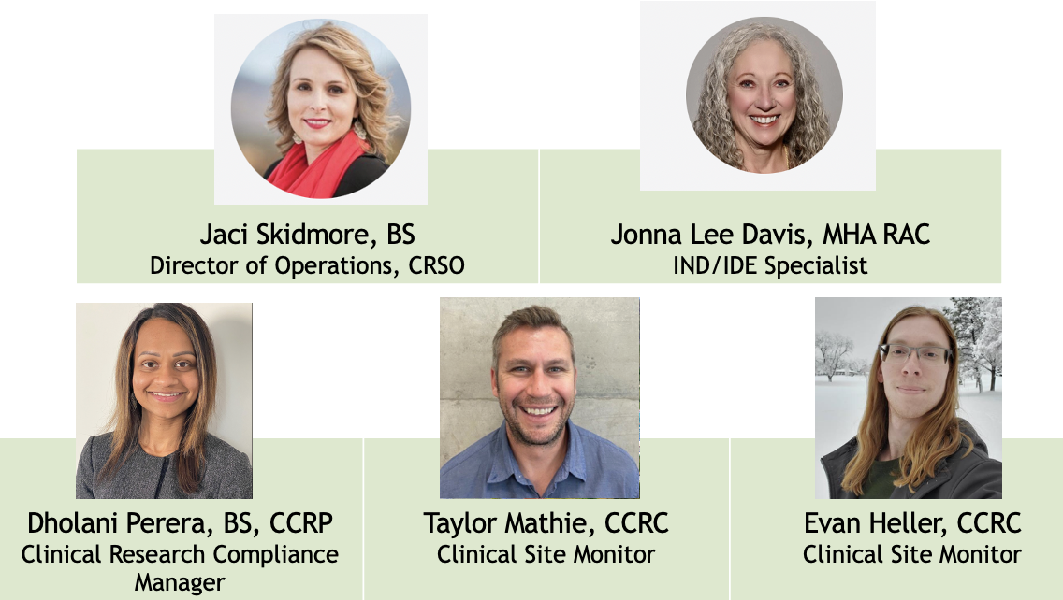
Clinical Research Support Office (CRSO)

Slide 19
Clinical Research Support Office (CRSO)
IND/IDE Support
What can the IND/IDE specialist do for you?
Coordinate pre-IND/IDE consultation meetings with the FDA
Assist with all FDA submissions for IND and IDE studies- includes initial submission, amendments, annual progress reports, and safety reporting
Serve as the primary point of contact with the FDA
Maintain master IND and IDE files
Assist with monitoring visits and audits
Please visit https://ctsi.utah.edu/crso/ind-ide for additional information and services provided
Requesting Services
Email jonna.lee.davis@hsc.utah.edu or CRSO.FDAsupport@hsc.utah.edu

Slide 20
Clinical Research Support Office (CRSO)
Quality Assurance Team
The sponsor is responsible for ensuring that a study is adequately monitored
based on considerations such as the objective, purpose, design, complexity, blinding, size, and endpoints of the trial
The sponsor should develop a monitoring plan that is tailored to the specific human subject protection and data integrity risks of the trial

Slide 21
Clinical Research Support Office (CRSO)
Quality Assurance Team
Current Services
Sponsor-Investigators holding an IND/IDE:
Pre-IRB IND/IDE audit
Routine risk-based monitoring for the duration of the study
All Investigators:
FDA audit support
Non-FDA audit support (e.g., European Medical Agency (EMA), sponsor GCP audit, etc.)*
Additional Services*:
Protocol review and development,
Protocol risk assessment
Monitoring plan review and development
Case Report Form (CRF) review and development
Deviation analysis and reporting guidance
Corrective and Preventative Action (CAPA) consultation
Source Data Review and Verification (SDV)
Staff training re: any of the services provided or monitoring components
*Non-FDA Audit Support and Additional Services are provided on a case-by-case basis.

Slide 22
Clinical Research Support Office (CRSO)
Quality Assurance Team
What do we review when we monitor a study?
Regulatory Essential Documents
Consent documents and the consent process
Eligibility Criteria
Participant source documents
Investigational Product (IP) Accountability
Primary endpoint and critical data source review and verification
Safety and deviation assessment and reporting
Suspected Unexpected Serious Adverse Reactions (SUSARs)
Other items as needed depending on the complexity of the trial

Slide 23
Clinical Research Support Office (CRSO)
Quality Assurance Team
Requesting Services
ProTracks:
The Clinical and Translational Science Institute (CTSI) REDCap Intake form
Can be accessed at the top of the CRSO webpage, here: https://ctsi.utah.edu/crso
E-mail to crsoqa@hsc.utah.edu

