Slide 1
Research Integrity Officer (RIO) Zachary Mitchell Office of the Vice President for Research Integrity & Compliance March 26, 2024

Slide 2
Mission and Services
Mission:
Ensure integrity in in the proposal, performance, review, and reporting of research activities.
Promote the safe and respectful treatment of all individuals associated with University research activities and environments.
The RIO has the expertise, responsibility, and authority to:
Manage allegations of research misconduct and the process for addressing and resolving allegations (as defined in University Policy 7-001).
Facilitate the resolution of complaints and concerns of unprofessional behavior occurring in the research environment through coordination with cognizant University leadership and administrative offices.
Develop and advance University regulations related to all areas of research integrity.
Design and implement education and training to
promote ethical, responsible, and professional conduct of research, in addition to other critical topics related to research integrity and compliance.
prevent research misconduct, detrimental, and questionable research practices (DRPs and QRPs).

Slide 3
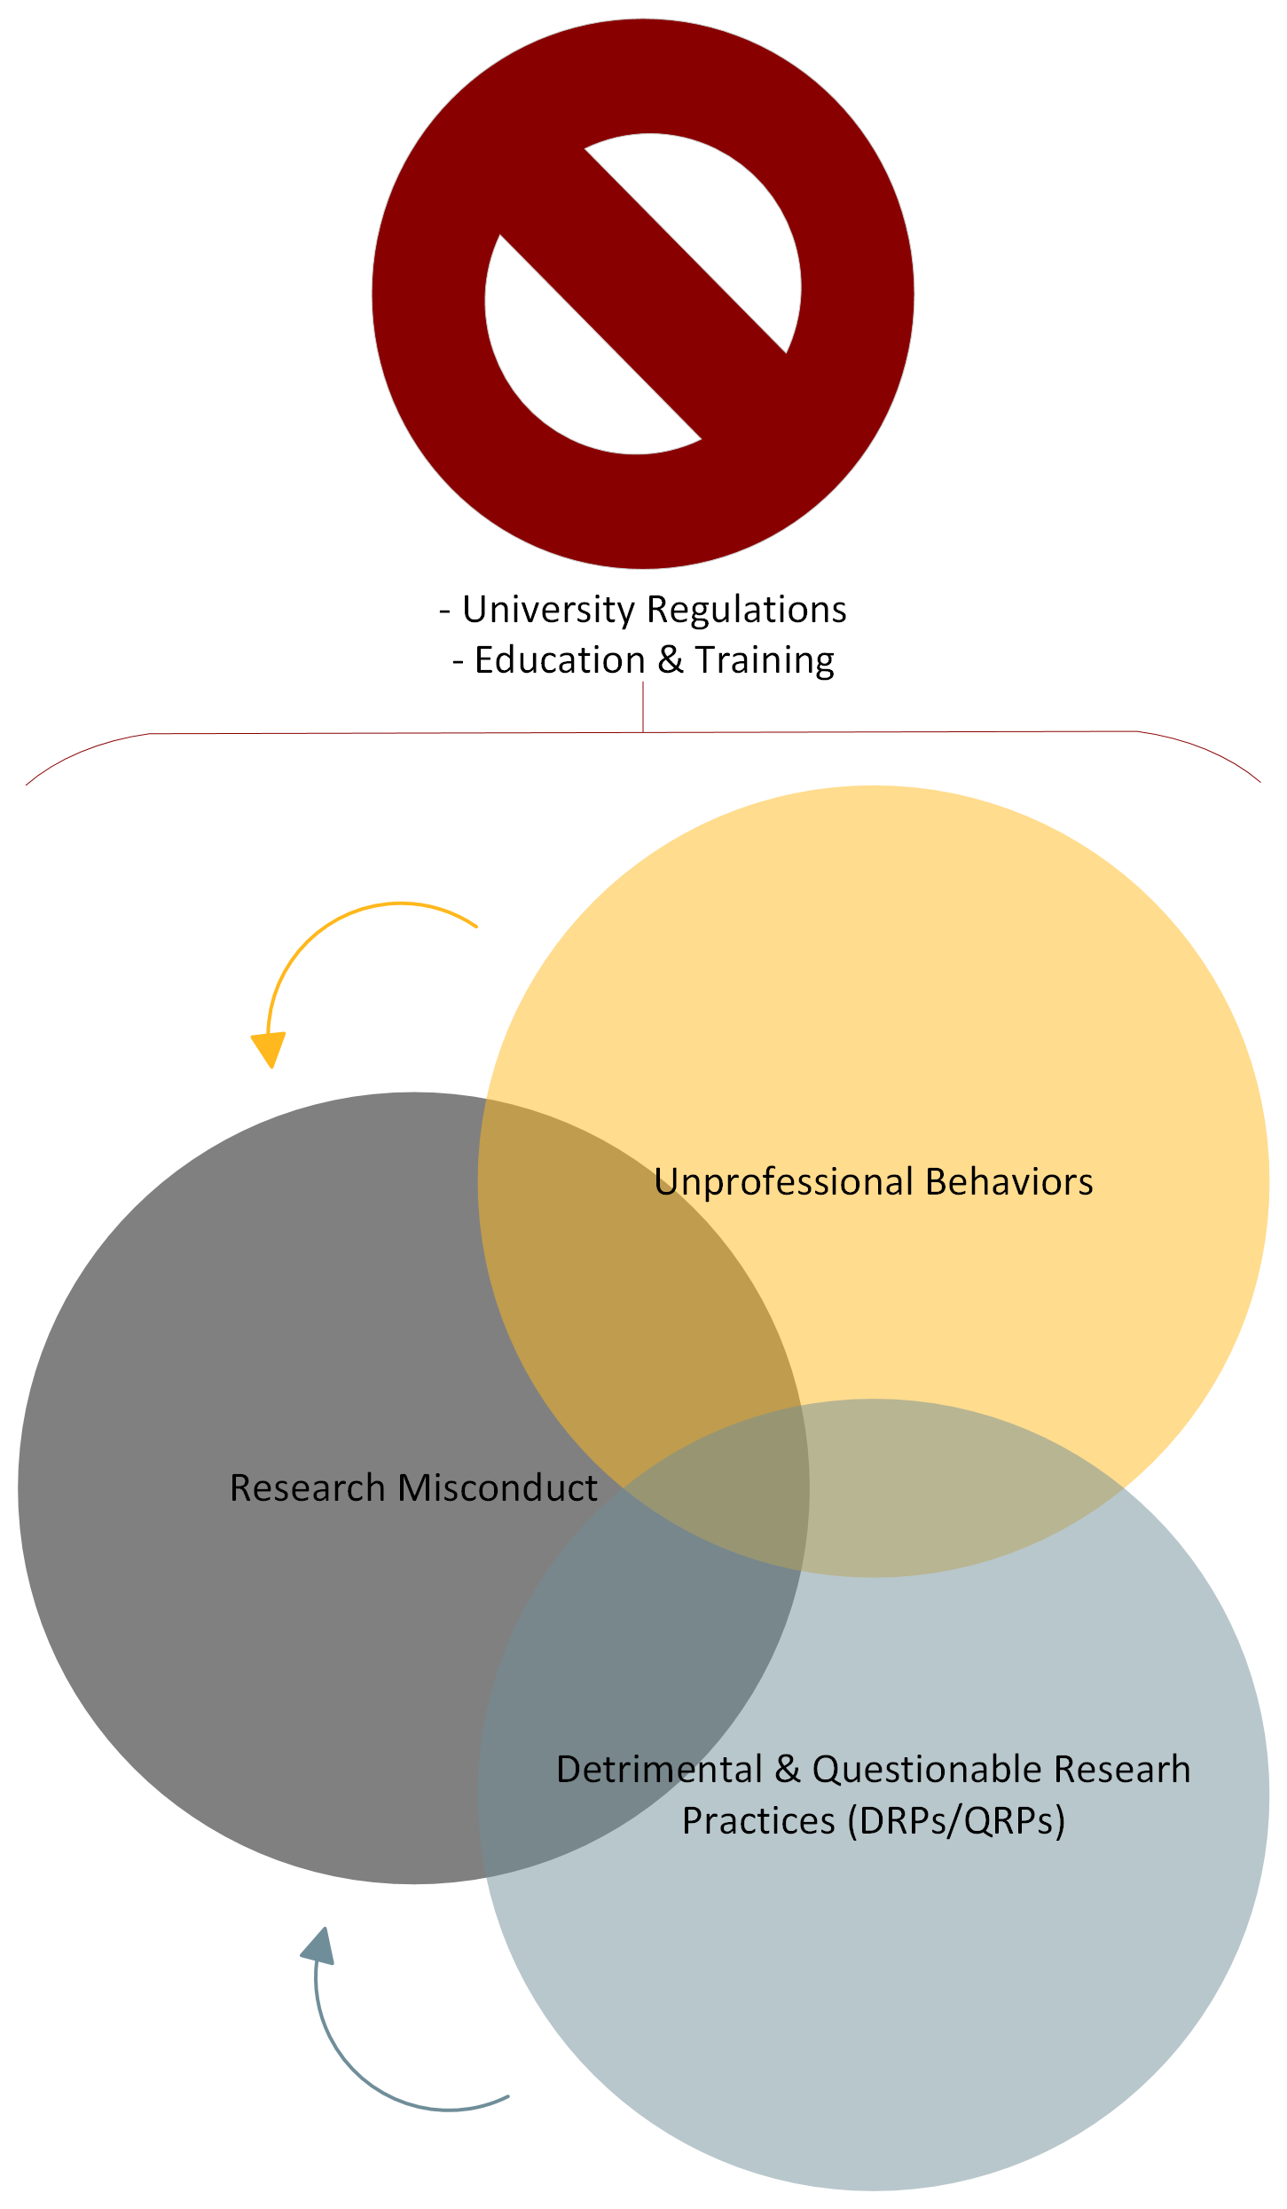

Slide 4
Scenarios
Two researchers collaborated on a grant application to a federal agency that was unfunded. After some time passes without making any progress on the proposal, one of the researchers redevelops the application and resubmits. Is this plagiarism?
What if the other author’s contributions (e.g., their ideas and writing) were removed prior to resubmission?
ORI Proposed Revisions to 42 CFR § 93.230(b): “Plagiarism does not include self-plagiarism or authorship or credit disputes including disputes among former collaborators who participated jointly in the development or conduct of a research project.”

Slide 5
Scenarios
A researcher consults with a colleague from another lab and ends up using an innovative assay that was developed by the colleague. No citation or acknowledgment is provided in the methodology section. An allegation of plagiarism is submitted. Is this research misconduct?
ORI Proposed Revisions to 42 CFR § 93.230(a): Plagiarism includes the unattributed verbatim or nearly verbatim copying of sentences and paragraphs from another's work, which materially mislead the reader regarding the contributions of the author. It does not include the limited use of identical or nearly-identical phrases which describe a commonly-used methodology.

Slide 6
Scenarios
A researcher comes to your institution from another University where they have recently published an influential manuscript in a high-profile journal. After establishing a lab at your institution, the researcher submits for and is awarded a grant based on the work at the previous University. Allegations are then raised that the researcher falsified and fabricated data in the published research from the previous University. Which institution is responsible for assessing the alleged research misconduct?

Slide 7
Andrea is a study coordinator in a cardiovascular department clinical trial unit assigned to support the department chair, Dr. Smyth, in enrolling participants into a clinical trial to test the safety of Therapy A. The study is being conducted within a consortium, which Dr. Smyth feels is important to perform well in. The study is not going well, however, due to strict blood pressure (BP) inclusion criteria. Despite significant efforts by Andrea to recruit participants to this difficult study, Dr. Smyth begins pressuring Andrea to increase enrollment, calling and texting her in the evenings and early mornings, insisting that she stop working on other projects to focus exclusively on recruitment for Therapy A, emailing her and Cc’ing her supervisors, suggesting that if she can’t reach enrollment goals that she can’t “cut it” in research.

Slide 8
Suddenly, enrollment starts to increase, and for a few weeks, Dr. Smyth is very pleased. However, after about a month, a research assistant on the team responsible for data entry, starts to receive queries from the study sponsor questioning the enrollment BP of each new enrollment over the last month because of the significant differences from pre-enrollment values from the participant’s medical records. Paul mentions the discrepancy to Dr. Smyth, who accuses Andrea of knowingly recording lower BP values to get them past inclusion criteria.

Slide 9
Research Misconduct (RM)
The Federal Office of Research Integrity (ORI), who has oversight for all investigations of RM involving Public Health Service (PHS) funds has identified several factors that regularly contribute to RM. These statements have been taken from real case interviews:

Slide 10
Risk Factors for Research Misconduct (RM)

