Slide 1
New NSF 24-1Requirements: Malign Foreign Talent Recruitment Programs
Implementation of the common forms for bio sketch and current & Pending (Other) SUPPORT and SciENCV certifications

Slide 2
Presenters
Todd Bjorklund Associate Director, Federal and Foundation Grants & Contracts Office of Sponsored Projects todd.bjorklund@osp.utah.edu - NSF requirements
- Implementation of Common Forms for Biographical Sketch and Current & Pending (Other) Support
- SciENcv certifications and re-certifications
Trent Foxley Director Office of Foreign Influence trent.foxley@hsc.utah.edu foreigninfluence@utah.edu - Risks of malign foreign talent recruitment programs - UUl foreign disclosure requirements

Slide 3
Federal Concerns: Research Security & Undue Foreign Influence
Due to concerns over the past few years, many federal funding agencies, including the National Science Foundation (NSF), have revised what information they require from investigators to appropriately assess available resources and other sources of support.
As part of this effort, NSF included updated requirements in the annual release of the 24-1 Proposal & Award Policies & Procedures Guide (PAPPG).
24-1 addresses Section 10632 of the CHIPS and Science Act of 2022 (42 U.S.C. § 19232) regarding malign foreign talent recruitment programs
24-1 implements the Common Forms for Biographical Sketch and Current & Pending (Other) Support and harmonize content requirements
National Defense Authorization Act (NDAA) 2021, Section 223 requires that disclosures be “accurate, current, and complete”

Slide 4
Changes to the NSF PAPPG 24-1 Effective May 20, 2024
Parties to Malign Foreign Talent Recruitment Programs
___ NSF defines senior/key personnel as individuals “who contribute in a substantive, meaningful way to the scientific development or execution of a research and development project”.
This definition includes the PI/co-PI and can include faculty associates and post-docs.
In accordance with NSPM-33 Implementation Guidance, it typically does not include grad students.
Notes:
It is incumbent on each federal agency to issue detailed instructions on the certification requirements that apply specifically to that agency. Today we are only discussing the new NSF requirements.

Slide 5
Malign Foreign Talent Recruitment Programs (FTRPs)
By NSF definition, a malign FTRP must involve a “foreign country of concern”:
China
Iran
North Korea
Russia
Or “entities of concern”:
entities in countries of concern
an academic institution on the National Defense Authorization Act (NDAA) of 2019 Section 1286(c)(8) List
a foreign talent recruitment program on the NDAA 2019 Section 1286(c)(9) List
AND…
_______
https://new.nsf.gov/policies/pappg/24-1#definitions
Notes:
These links (and more info) can be found on the OSP website: https://osp.utah.edu/policies/research-security/malign-foreign-talent-recruitment-programs.php

Slide 6
Malign Foreign Talent Recruitment Programs (FTRPs)
Is Any Program, Position, or Activity
that includes compensation in the form of cash or in-kind compensation
research funding
promised future compensation
complimentary foreign travel
things of non de minimis value,
honorific titles,
career advancement opportunities,
other types of remuneration or consideration
IN EXCHANGE FOR…

Slide 7
Malign Foreign Talent Recruitment Programs (FTRPs)
Problematic Obligations or Activities
Red Flags include, but are not limited to
Unauthorized transfer of IP/data
Requirement to not disclose involvement
Entering into a contract with an individual, not the University
Inability to terminate the contract
Focuses on replicating or overlapping US funded research programs
See complete list at - https://osp.utah.edu/policies/research-security/index.php

Slide 8
New Requirement: Key Personnel Certification
Senior/key personnel are now required to certify via SciENcv that they are not participating in malign FTRP
Certification required in each NSF application
If you suspect you may have been contacted about an opportunity to join or become associated with any FTRP, request a consult with the Office of Foreign Influence.

Slide 9
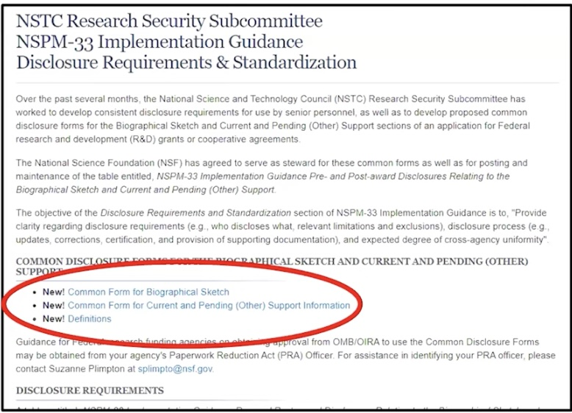
Federal Implementation of the “Common Forms”
Federal sponsors, in conjunction with OSTP (the Office of Science and Technology Policy) and NSTC (National Science and Technology Council), have been working to harmonize some of the common forms and disclosures they require for senior/key personnel - specifically:
Biographical Sketch and Current & Pending (Other) Support.
Per the NSPM-33 implementation guidance, the Common Forms will replace other forms and formats that agencies currently use to disclose biographical sketch, and current and pending (other) support information, when applying for federal research funding.
_____
https://www.nsf.gov/bfa/dias/policy/nstc_disclosure.jsp

Slide 10
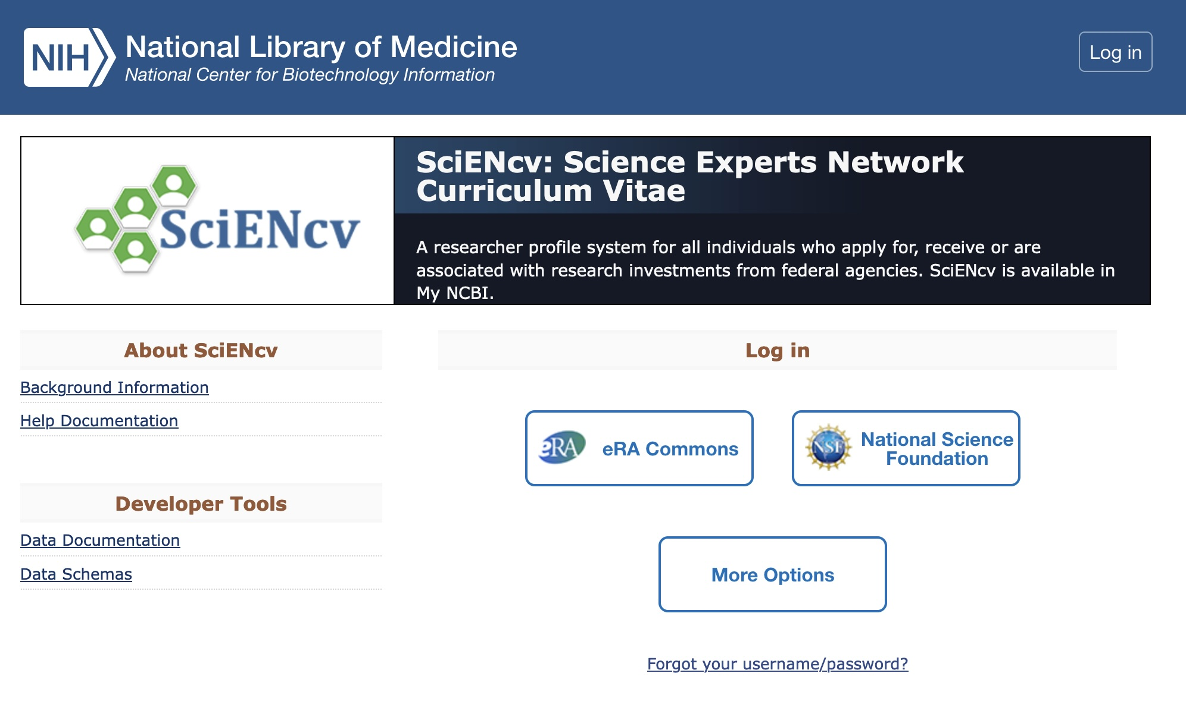
Common Forms through SciENcv
Must now use the Bio Sketch Common Form
Bio sketch page limits removed
Synergistic Activities section removed
Now separate 1 page upload
Must now use the Current and Pending (other) Support Common Form
Each document must be provided separately for each senior/key person through the use of SciENcv (Science Experts Network Curriculum Vitae)
__________
https://osp.utah.edu/policies/research-security/federal-disclosure-requirements.php
Notes:
The link is to info on NSF disclosure requirements

Slide 11
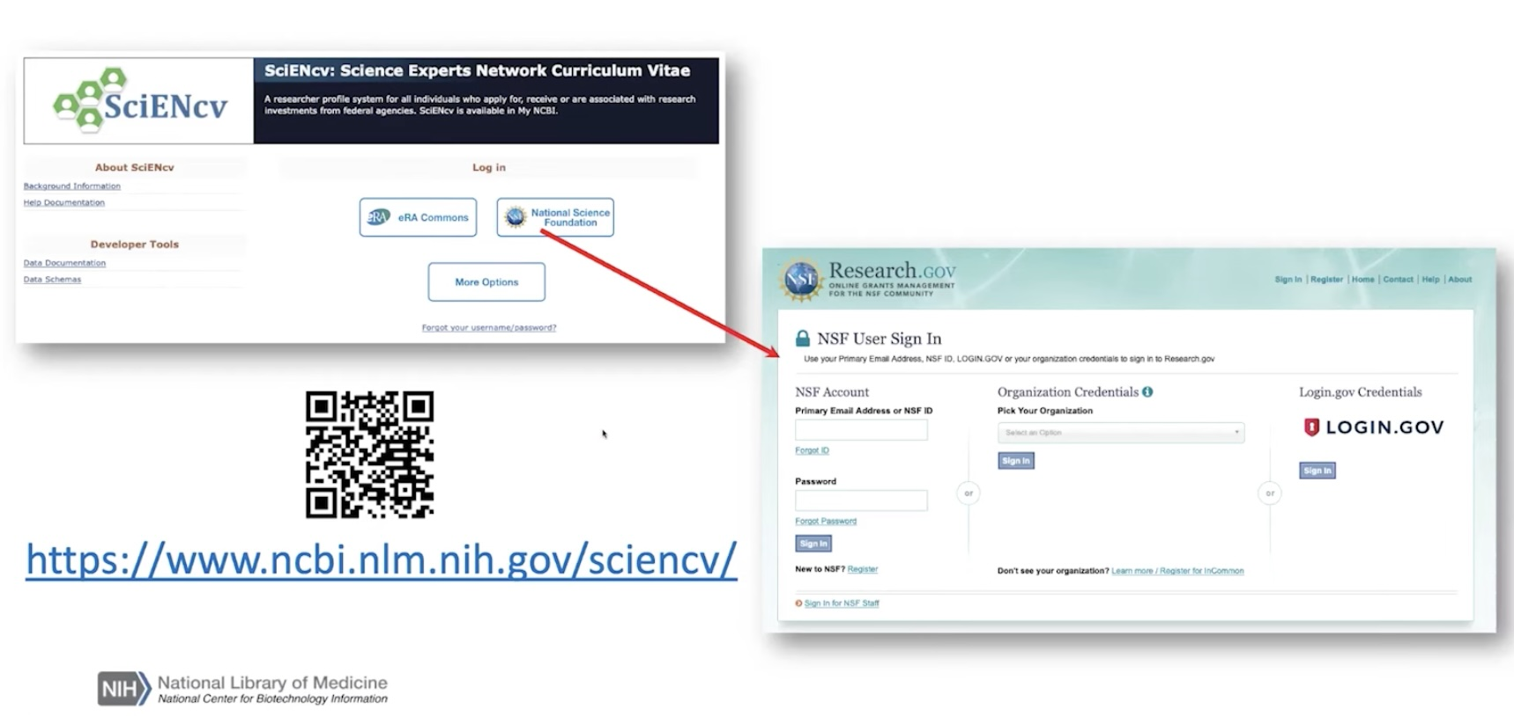
SciENcv NSF Login Pathway
By clicking on the NSF link, you’ll be redirected to Research.gov credentials to authenticate and then redirected back to SciENcv where you can access your profile

Slide 12
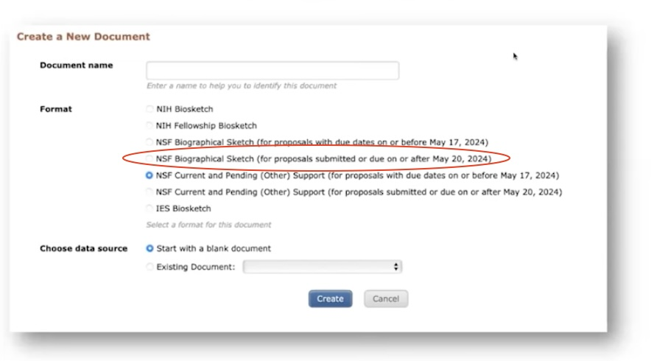
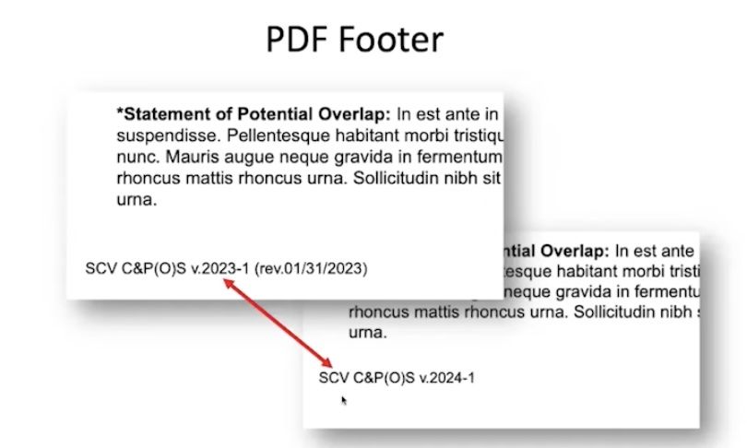
SciENcv Create New Form
UPDATE current forms by ‘copying the information to the new format’ link
Save synergistic activities first – they will not be carried over
If creating a new form in SciENcv be sure to select the format for ON OR AFTER MAY 20, 2024
You can create multiple versions to highlight different things for different proposals
The footer will help you identify whether you have the correct 2024 version

Slide 13
Biographical Sketch & Major Changes
Required for each individual identified as a senior/key person
Used to assess how well qualified the individual, team or organization is to conduct the proposed activities
Individuals are required to disclose contracts associated with participation in programs sponsored by foreign governments, instrumentalities, or entities, including foreign government sponsored talent recruitment programs
Must be created in SciENcv (continuing requirement)
NEW: Page limits removed
NEW: Must certify that they are not party to a malign FTRP

Slide 14
Biographical Sketch & Major Changes
NEW
Synergistic Activities moved to 1 page upload for each senior/key persons
Definitions added for institutional, professional, and academic positions and appointments (included in updated NSF Definitions document)
Parameters have been added re: professional appointments
“With regard to professional appointments, senior/key persons must only identify all current domestic and foreign professional appointments outside of their primary organization”
Guidance revised re: listing of products “The listing of products provided should be organized by the senior/key person in a way that best demonstrates their ability to carry about the research proposed.”

Slide 15
Current & Pending (Other) Support Major Changes
Required for each individual identified as a senior/key person
Used to assess the capacity or any conflicts of commitment that may impact the ability of the individual to carry out the research effort as proposed
Helps assess any potential scientific and budgetary overlap/duplication
Must be created in SciENcv (continuing requirement)
NEW: Must certify that they are not party to a malign FTRP
______
For details on NSF disclosure requirements and disclosure matrix (May2024): https://osp.utah.edu/policies/research-security/federal-disclosure-requirements.php

Slide 16
Current & Pending (Other) Support Major Changes
New
Revised definition of in-kind contribution: “In this section, please disclose all in-kind contributions with an estimated dollar value of $5000 or more and that require a commitment of the individual’s time.”
Consulting activities must be disclosed under Proposals and Active Projects Section of the form when any of the following scenarios apply:
Consulting activity will require the senior/key persons to perform research as part of the consulting activity;
Does not involve performing research, but is related to the senior/key person’s research portfolio and may have an impact to funding, alter time or effort commitments, or otherwise impact scientific integrity;
Consulting entity has provided a contract that requires the senior/key person to conceal or withhold confidential financial or other ties between the senior/key person and the entity, irrespective of the duration of the engagement.

Slide 17
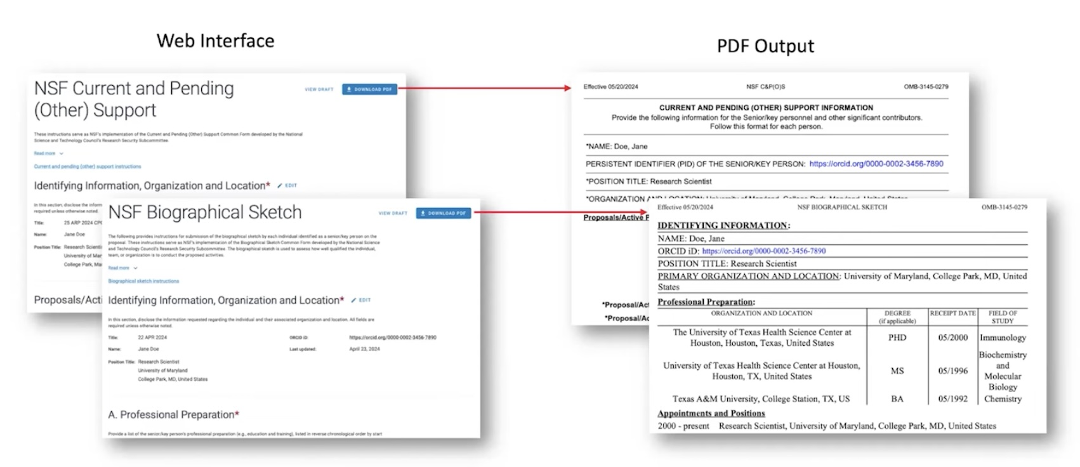
SciENcv
SciENcv will produce NSF compliant PDF versions of the forms

Slide 18
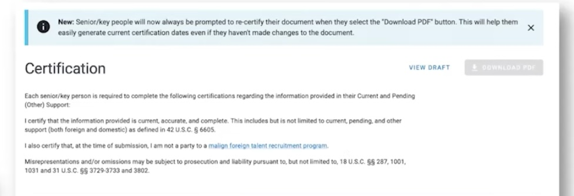
SciENcv Certification
Senior/key personnel must log into SciENcv to manage personnel documents and/or add RA staff as delegates
Senior/key personnel must prepare, save, & CERTIFY
Personnel will be prompted to re-certify each time they download
Re-certifying creates a new timestamp
Notes:
PI’s can assign a delegate in SciENcv via Account Settings. Delegates can work on the documents but can not certify on the other person’s behalf.

Slide 19
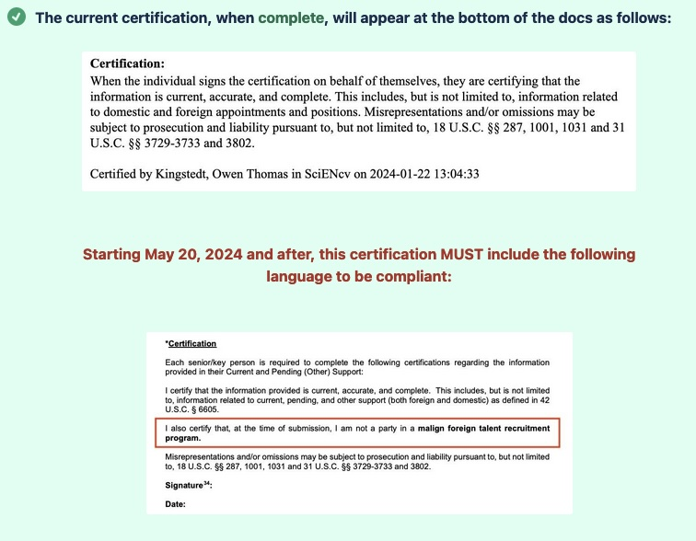
SciENcv
Information provided must be “current, accurate, and complete”
After May 20th, the forms must include certification that:
“I am not a party in a malign foreign talent recruitment program”

Slide 20
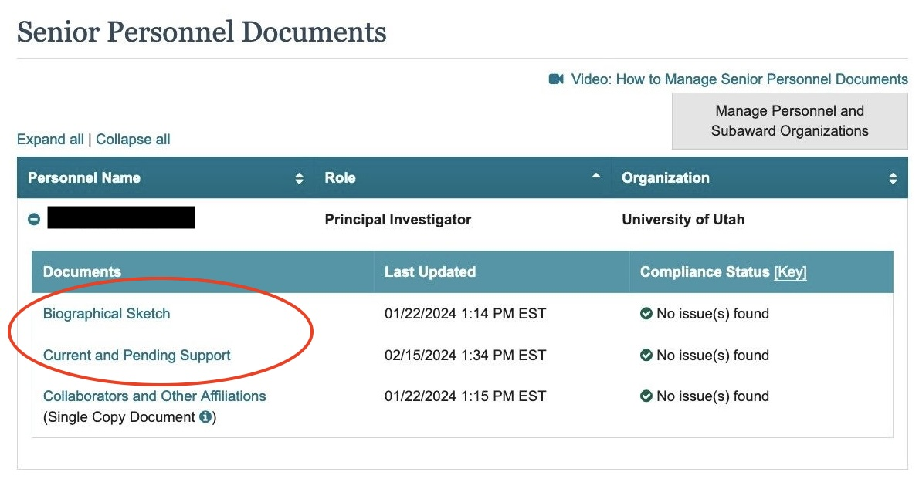
Research.gov
The certified forms must be attached under Senior Personnel Documents as part of each proposal in Research.gov

Slide 21
OSP Submission: Non-compliant Proposals will be Withdrawn
As of May 20, each time OSP submits an application in Research.gov, we must attest on behalf of the institution that all senior/key personnel in the application have certified that they are not party to an MFTRP
OSP will not be able to submit an NSF proposal without the correct signed certifications for each senior/key personnel
OSP will have to withdraw proposals without the correct signed certifications for each senior/key personnel, if already submitted
If OSP is not able to review an application prior to submission, we will review it after to check for the certification statements
OSP will consult with the PI but non-compliant proposals will be withdrawn

Slide 22
Award Process and Re-certification
Prior to making funding recommendations, the NSF Program Officer will request updated versions of the Current and Pending (Other) Support be submitted via Research.gov
Re-certification is required annually thereafter for the duration of the award
NEW: Updated and re-certified Current and Pending (Other) Support must be disclosed to NSF when annual and final progress reports are submitted.
_____
For details on NSF disclosure requirements and disclosure matrix (May2024): https://osp.utah.edu/policies/research-security/federal-disclosure-requirements.php

Slide 23
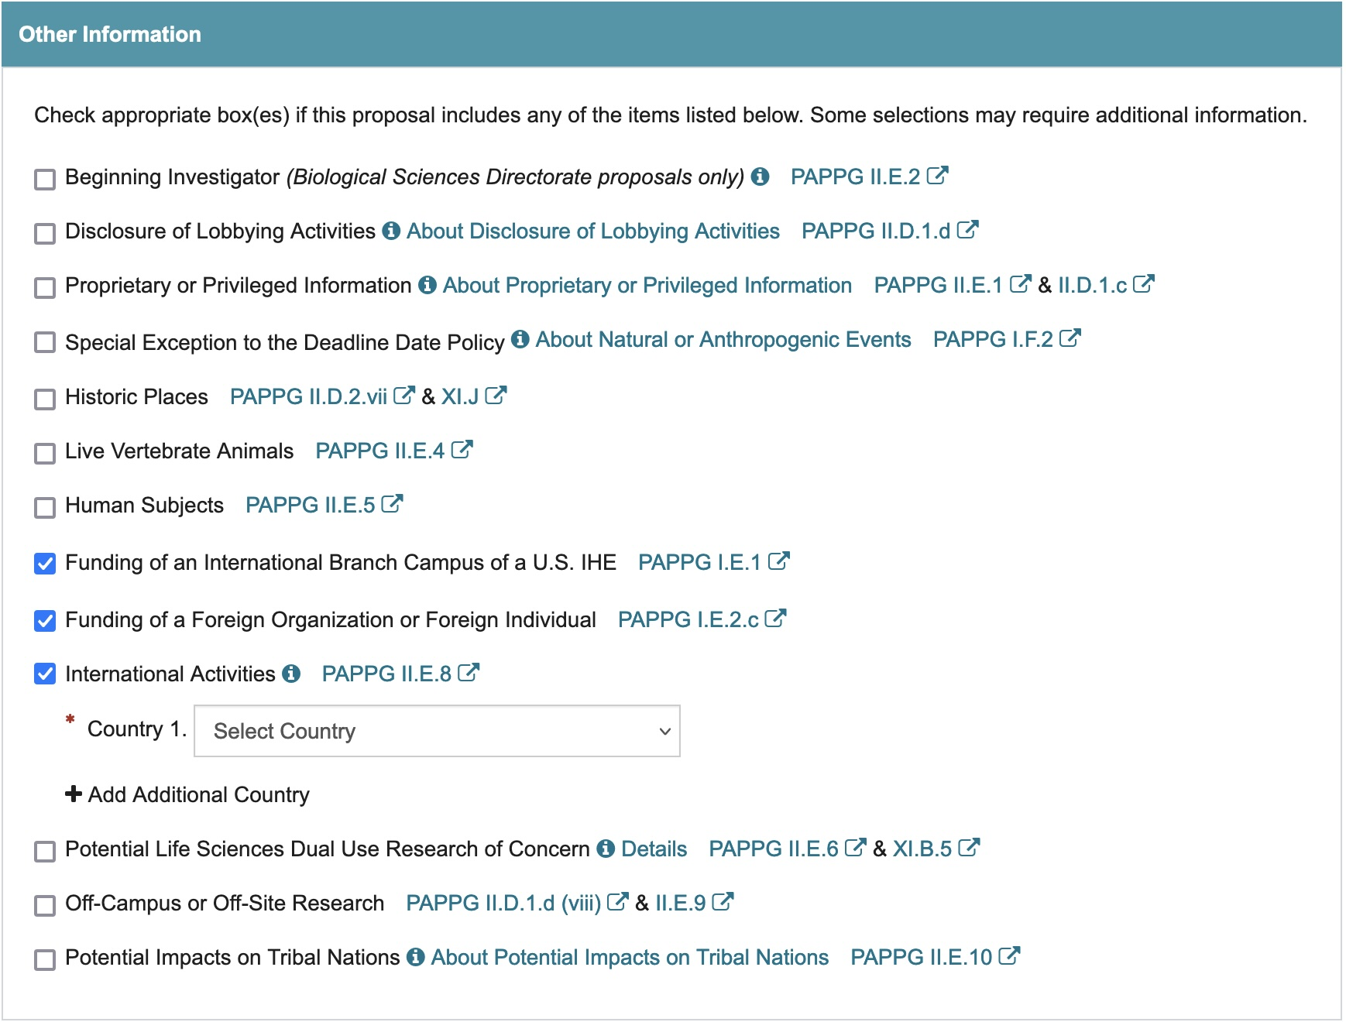
Reminder: International Collaboration
Within each proposal, applicants are required to mark intended partnerships with international collaborators on the NSF Cover Page under three circumstances
International Activities
If foreign travel is budgeted check here and list countries involved
If foreign country is unknown, use the “worldwide” option
Do not list more than 5 countries
Funding of an International Branch Campus of a U.S. Institution of Higher Education (IHE)
This includes use of subaward or consultant arrangement
Funding of a Foreign Organization
If foreign org is involved, including subaward or consultant arrangement, check here and provide justification in project description

