Slide 1
UTAH CTSI |
Clinical & Translational Science Institute
CLINICAL RESEARCH RESOURCES & SERVICES
AT THE UNIVERSITY OF UTAH
September 14, 2021
Dixie D. Thompson, BSN, RN
Director, Research & Science
CTSI Clinical Services Associate Program Director

Slide 2
Compliance Café at the University – and what to expect in today’s presentation
Disclaimer – I can’t speak for the entire CTSI, but I can tell you what I know or what I think I know…

Slide 3
Q1. CTSI – CCTS – CTSA: What’s the difference?
CTSI Clinical & Translational Science Institute
CCTS Center for Clinical & Translational Science, previously
CTSA Clinical & Translational Science Award
National NIH Program & Institutional Award
Funded since 2008 through National Center for Advancing Translational Sciences (NCATS)
Academic Home for Clinical & Translational Science

Slide 4
Q2. How / Why an Institute?
CTSI Clinical & Translational Science Institute
“Institute” conveys our expanding Translational Science role within the state of Utah and nationally
Strong collaborations across campus, Intermountain Healthcare, Utah DoH, SLC VA, UU Health Regional Affiliates, and Community Faces of Utah, and with Regional and National Networks.
Provides the University Research Community:
Expertise and Infrastructure

Slide 5
“When clinical research reveals a new or better way to treat a health condition, it can take up to 14 years to get that knowledge out to the masses,” Hess said. “The CTSI helps ensure that the community has access to these discoveries sooner; to go beyond just saying ‘it works’ and actually pushing it from the pre-clinical space to patient access and opportunities.”
Rachel Hess, MD,CTSI Co-Director
CTSI.UTAH.EDU

Slide 6
Q3. Expertise?
Institute designation required serial approvals from governing bodies both internal and external to the University - “Utah CTSI”
Ongoing Strategic Leadership collaborations:
CTSI, VPR, CEO UUtah Health and SVPs office, AVP for Health Sciences Research, Dean’s Office, and multiple leadership committees from across University and partners
CTSI areas of expertise across the Translational Spectrum include:
Education & Training for future workforce development
Informatics, Biostats, Population Science, Data Science, other technical expertise
Regulatory and Compliance
Clinical research venues and staffing
Translational Lab and Biobank
Community Collaboration and Engagement
Ethics, Diversity and Inclusivity
Precision Medicine
Research Participant Advocacy Sadie.Gabler@hsc.Utah.edu
Expert Navigation Ashley.Kapron@hsc.Utah.edu

Slide 8
Q4. INFRASTRUCTURE?

Slide 9
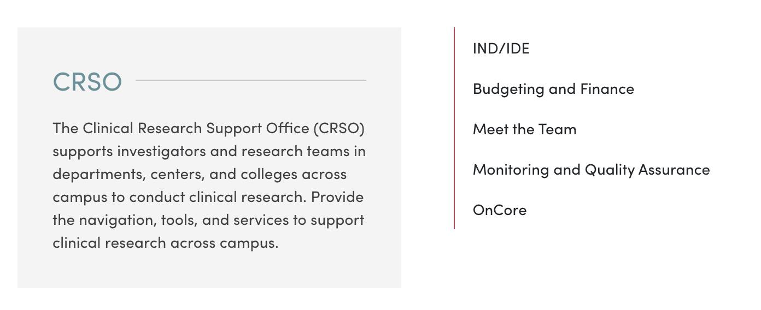
Q4. INFRASTRUCTURE? cont.
Director, Clinical Research Operations: Jaci.Skidmore@hsc.Utah.edu

Slide 10
Q4. CTSI Projects AND COLLABORATIONS?
CRSO - OnCore and Epic Research Module Implementation
COVID Clinical Trials and Surveillance or Epidemiology Studies
Continuing Non-COVID clinical research; incl. Sleep lab and Metabolic Kitchen
Focus on Ethics in Clinical Research, Focus on inclusive and diverse participant recruitment, Focus on LifeSpan research, Focus on underrepresented populations
Improving study design; provisioning access to local/national resources
Utah Trial Innovation Center (Utah TIC) and Trial Innovation Network (TIN)
CTSA Program collaborations and CORES Consortium of Rural States
TriNetX, Aerotek
Primary Childrens’ Hospital
UU and SLC VA Medical Center collaborations
Improving HR job titles in Clinical Research
Communications Activities: New CTS, Pandemic impacts, Central Intake, new website
U-ACT (my own current favorite)

Slide 11
CTSI – Clinical Services Core
Resources and Services
J. Robinson Singleton, MD
Professor and Vice Chair for Research, Neurology, University of Utah
Program Director
Dixie D. Thompson, BSN, RN
Director, Research & Science, University of Utah
Associate Program Director

Slide 12
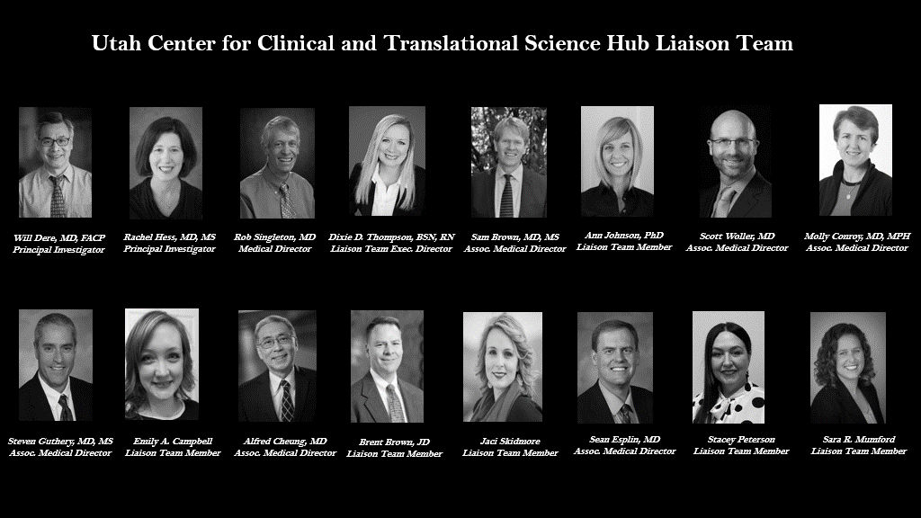

Slide 13
UTAH CTSI-CLINICAL SERVICES CORE (CSC)
and Hub Liaison Team Resources
Clinical Research Services: Expert Clinical Research Nursing, Nutrition & Clinical Space for the conduct of trials; UU Hospital 3NAC (inpatients), Wakara Outpatient, COVID Drive-thru, 5W COVID Research Unit, Mobile CRN. (Ph 1-4 trials) *Note: DXA hosted by CTSI at 3-NAC; Hillarie Slater, Technician and resource Mgr.
Clinical QPS: Quality and Patient Safety standards
Trials Performance Tracking: Nate Tevlin, Data Analyst (Trent Matheson, Director)
Utah Hub Liaison Team: Support/connect Investigators to CTSA Consortium collaborative activities, promote early study development resources, facilitate operational interactions across partners (Utah TIC, TIN Institutions, SLC VA, Intermountain, DOH)
Clinical Trial Intake: Industry opportunities, COVID, HEAL, TriNetX, others
Utah–Activation of Clinical Trials (UACT): “100 Day Industry startup” project Committee representation from VPRs office, Assoc. Deans, CTSI, IRB, OSP, HCI, IM, others, under direction of AVP-Health Sciences Research Dr. Dere and CTSI-CSC Medical Director Dr. Singleton.
Near-term goals: Continually improve CSC support for all lifespan research, projects embedded in the community & trials that include rural and frontier populations; collaboratively support study development & multi-center trials.
Questions? Dixie.Thompson@hsc.Utah.edu, Michelle.Adams@hsc.Utah.edu
CTSI|
Clinical & Translational
Science Institute
AT THE UNIVERSITY OF UTAH

Slide 14
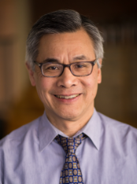
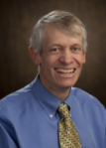
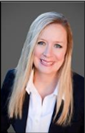
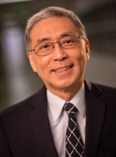
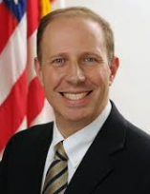
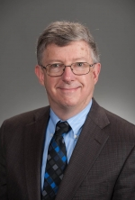
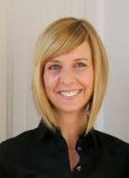
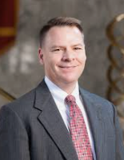
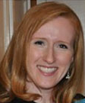
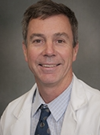
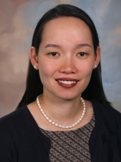
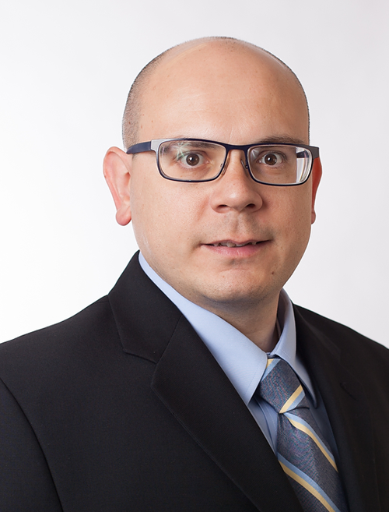
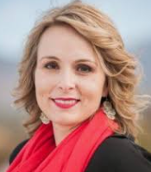
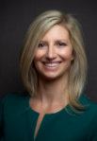
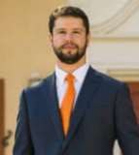
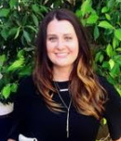
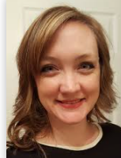
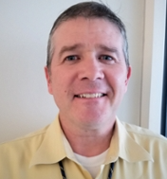
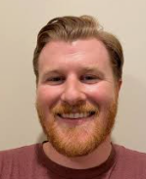
UACT Committee Membership 2021
Utah Activation of Clinical Trials
Alfred Cheung, MD
Vice Chair for Research, Internal Medicine
U-ACT Sr. Faculty Internal Medicine
Will Dere, MD
Associate Vice President for Research
U-ACT Chair
Rob Singleton, MD
Director, CCTS Clinical Trials Support
U-ACT Faculty Lead
Dixie D. Thompson, BSN, RN
Director, Research and Science
U-ACT Project Lead
Jon White, MD
Associate Chief of Staff Research, VA
SLC Health Care System
U-ACT Faculty SLC VA
J. Michael Dean, MD, MBA
Associate Dean for Clinical Research
U-ACT Leadership
Ann Johnson
Director, Institutional Review Board
U-ACT IRB
Brent Brown
Dir. & Assistant VP Office of Sponsored Projects
U-ACT OSP
Jessica Moehle
Director, Research & Science
U-ACT Research Ops HCI
David K. Gaffney, MD, PhD
Senior Director for Clinical Research
U-ACT Faculty HCI
Theresa L. Werner, MD
Medical Director, Clinical Trials Office
U-ACT Faculty HCI
Luca Boi
Value Engineer, Senior
U-ACT Value Engineer
Jaci Skidmore
Director, Clinical Research Operations
U-ACT Research Ops CRSO
Casi Morales, JD
Manager, Grants & Contracts
U-ACT Grants & Contracts
Trent Matheson
Director, Tracking & Evaluation
U-ACT Program Tracking
Stacey Peterson
CCTS- Clinical Trials Support
U-ACT Administrative Assistant
Vanessa Bryant
Manager, Accounting & Finance
U-ACT Sr. Budget Analyst
Emily Campbell
Clinical Trials Information Specialist
U-ACT Liaison Team Member
Scott Low, MBA,
Interim Director, Research Administration
U-ACT Research Ops Int. Medicine
Nathaniel Tevlin
CCTS Information Coordinator
U-ACT Information Coordinator

Slide 15
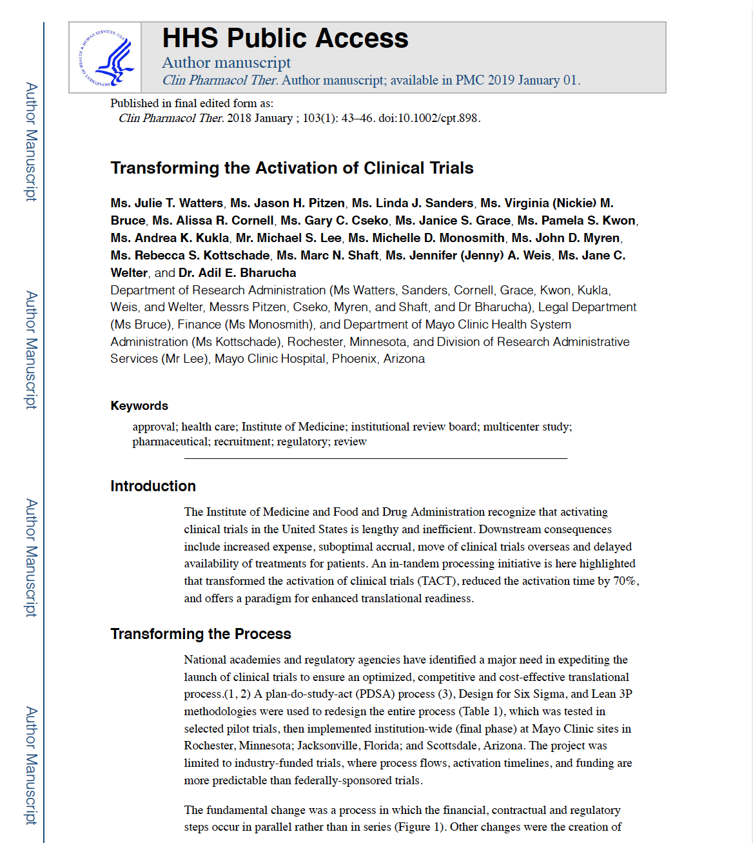
Utah Activation of Clinical Trials (UACT) BACKGROUND
Mayo TACT example and 2018 publication
Goal to streamline and standardize processes
Business Units to be responsible for their own performance expectations
Not content waiting for OnCore or CRSO improvements
Kick-off late 2020
Shared expectation set February 2021 – 80% of Industry-sponsored trials within 100 days. Short-mid term goals, longer term goals.
Will review data July 9, 2021
Two tier priorities in play but not defined

Slide 16
U-ACT Guiding Principles
We seek excellence in clinical research
1
Prospective clinical trials are an
Important part of clinical research
2
Global competition for
pharm-sponsored CTs is intense;
speed of clinical site
activation is an important criterion for sponsors
3
Pharma-sponsored CTs are attractive
due to access to innovative molecules/other interventions
4
Government-sponsored CTs
5
are frequently multi-center and are also competitive (witnessed by recent COVID experience)
The patient is waiting…
6
a clinical trial seeks to answer a biomedical/clinical question, and the question undoubtedly addresses the need of patients with the medical malady in question
GUIDING PRINCIPLES
Office of the SVP for Health Sciences Research, September 2020

Slide 17
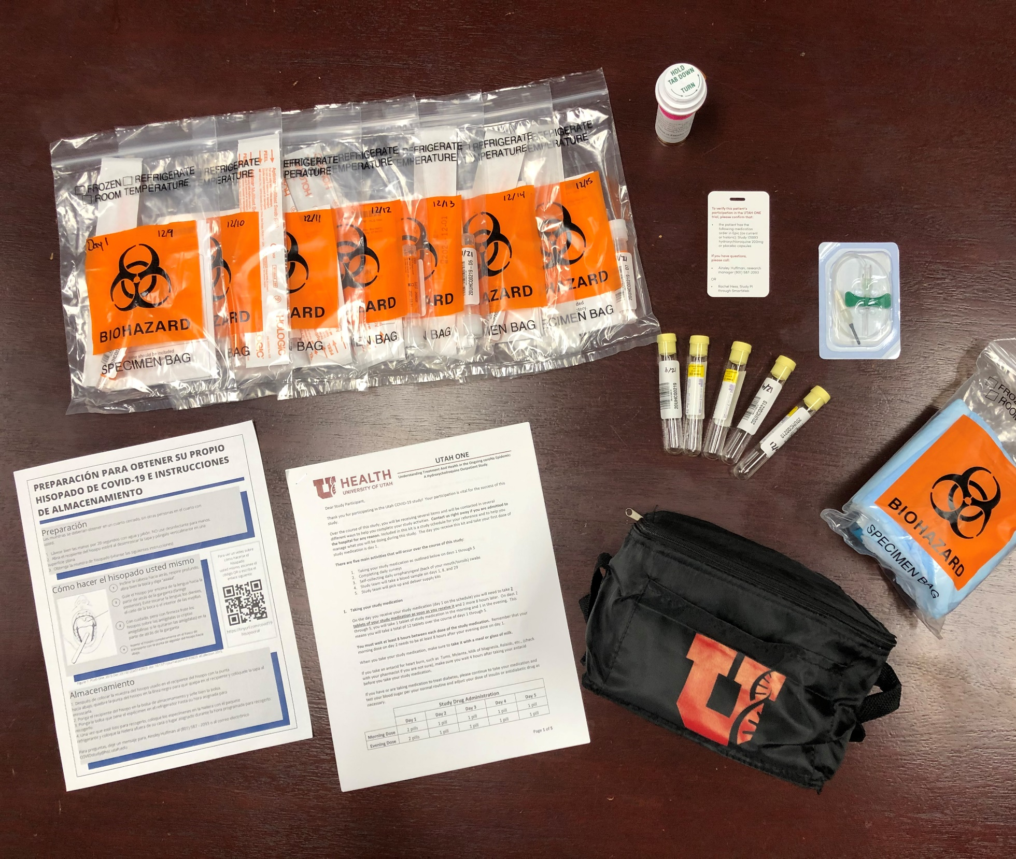
CLINICAL SERVICES CORE PERFORMANCE
Currently support 90+ active research studies at the University of Utah
COVID Studies include - Convalescent Plasma Trials, RECOVER clinic, C-HEART clinic, others
In April 2020, the CSC rapidly stood up Utah One as our first decentralized, in-home research trial, with additional “no touch” visits for data & specimen collection.
The COVID pandemic raised concerns for equitable access, appropriate use, and conservation of PPE. The CSC serves as the University distribution hub, or central PPE Czar, for PPE to research teams and tracks utilization.
Maintaining 421 Wakara as “COVID free” as possible provided clinical
research continuity not allowed at many other large Academic Health
Care Organizations.
Zero participant-to-HCW transmissions during hundreds of in-person
visits with new COVID positive patients
Nurse Manager: Michelle.Adams@hsc.Utah.edu
Notes:
And all of those kits!

Slide 18
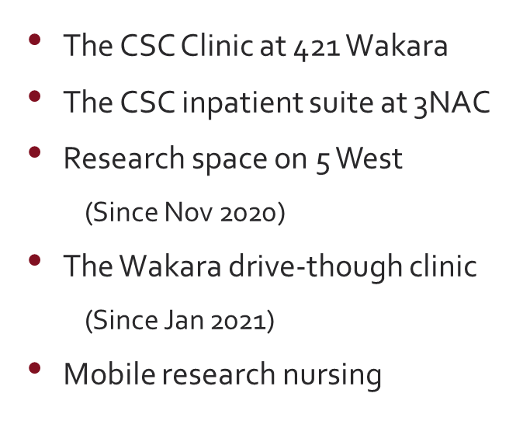
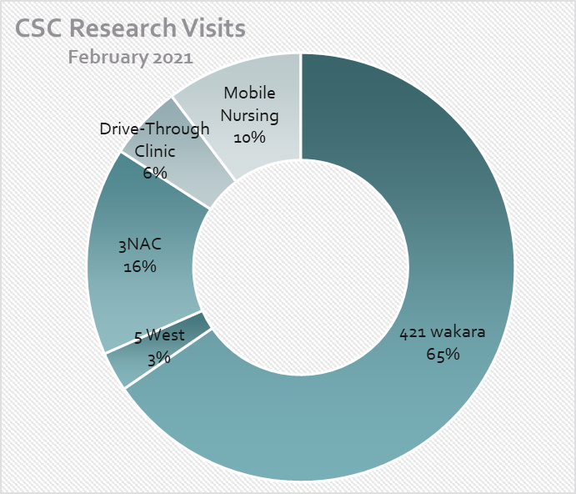
Research Community Support
The CSC Staffs Multiple Venues to Support our Research Community

Slide 19
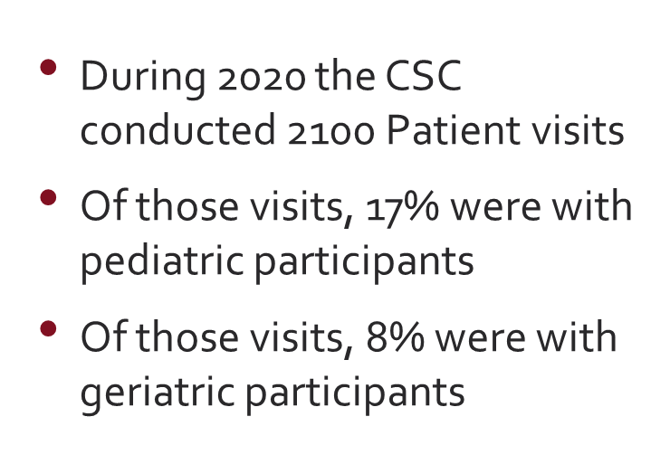
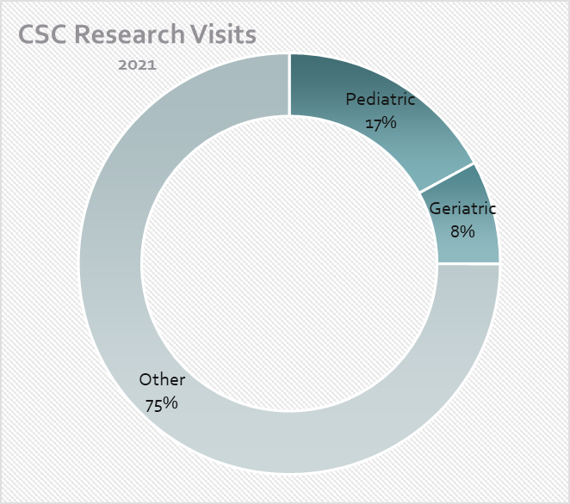
Diverse Population of Research Participants
The CSC Provides Care for a Diverse Population of
Research Participants

Slide 20
Noted Institutional Challenges in Clinical Trials
Participant Interactions: The CTSI Clinical Services Core fulfills the CTSA mission of participant interaction by providing safe clinical research facilities and equipment, a trained clinical research nursing workforce, and a Research Participant Advocate, translation and interpretive services, targeted Spanish-speaking hires, maintaining the highest standards for Quality and Patient Safety while ensuring fidelity to the research protocol. Resources include inpatient, outpatient, COVID + and non-COVID venues.
U-ACT - Clinical Trial Site Activation: Utah-Activation of Clinical Trials. The Utah CTSI Hub Liaison Team formed a working group to improve our clinical trial site activation processes, based on the work done by Mayo Clinic. Stakeholders from across the research enterprise held a process mapping exercise, set focal areas, and in February 2021 established a University of Utah Standard Industry Start-Up target of 100 Days.
COVID-19 Related Clinical Trial Implementation: The Utah CTSI is contributing to the successful performance of several trials related to the COVID-19 pandemic. Network trials and U Utah investigator initiated clinical research opportunities pose challenges for key leaders/business units in prioritizing research resources and adequately serving potential inpatient and outpatient research participants. Successful implementation of multiple single and multi-site COVID-19 related trials continues to require unique facilities, staffing and close internal communication and timely partnerships with external stakeholders.

Slide 21
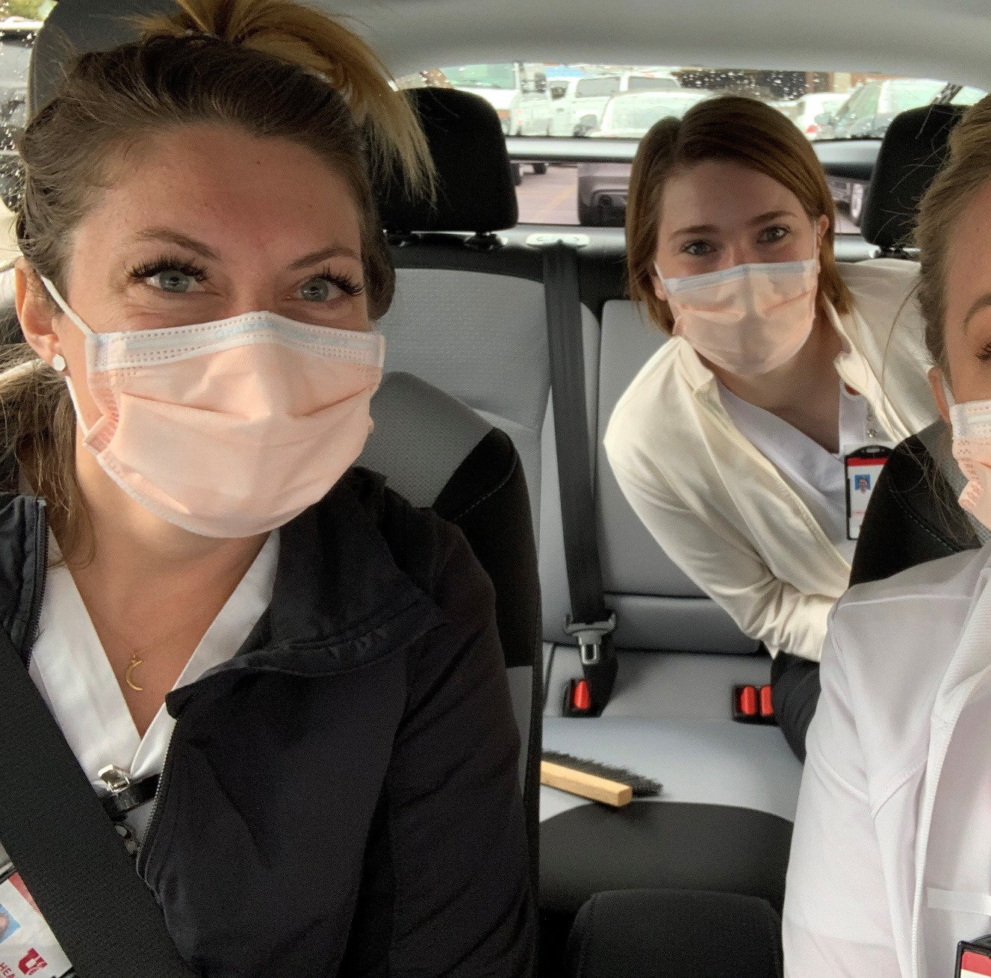
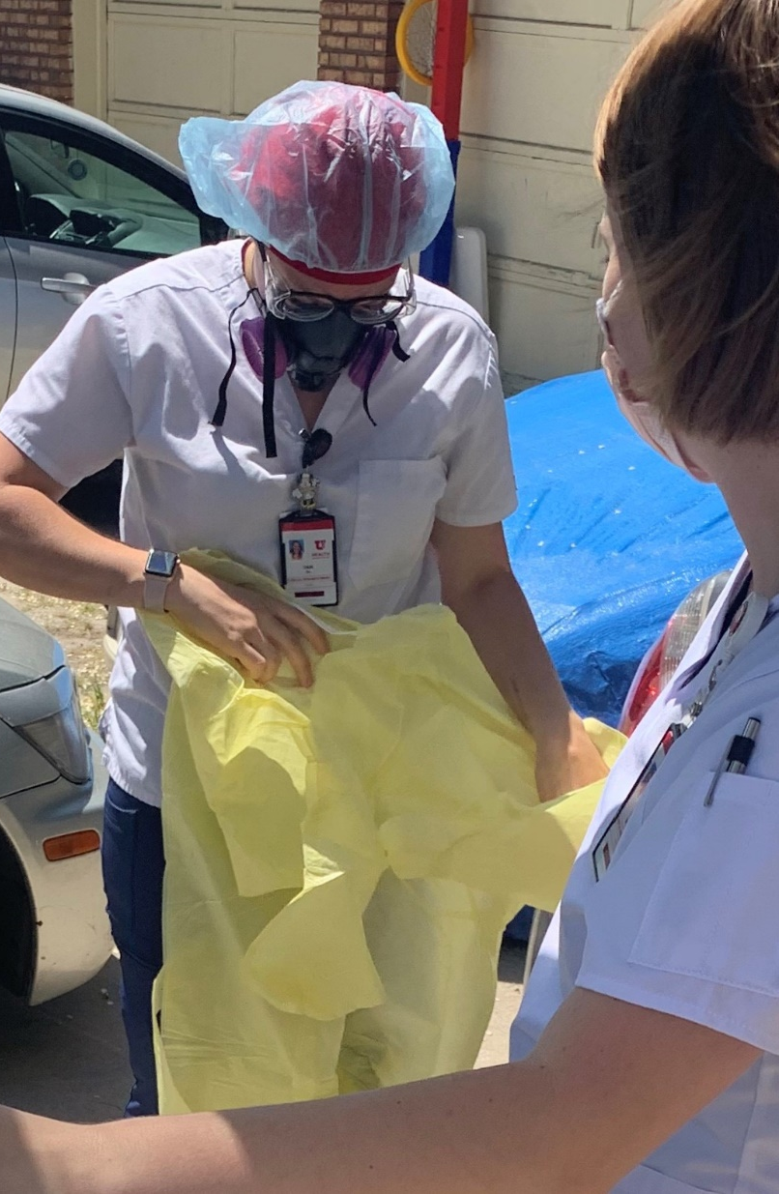
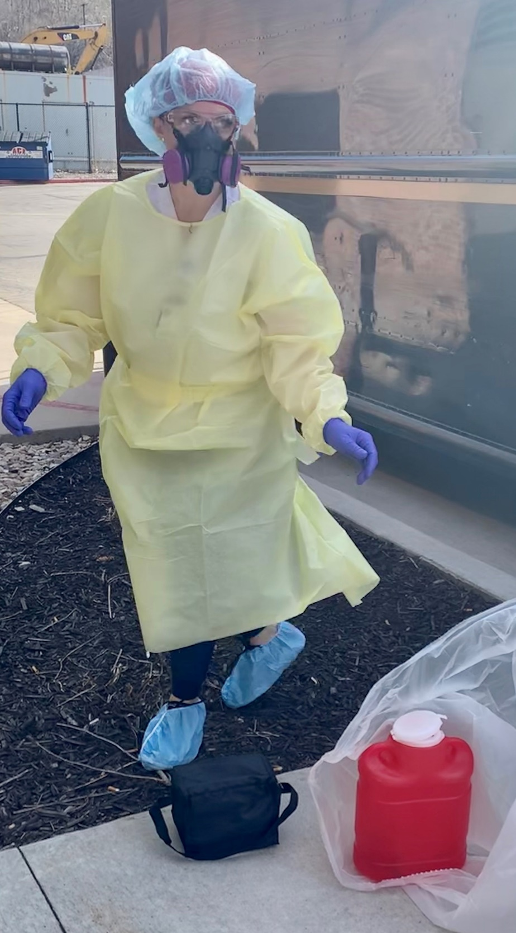
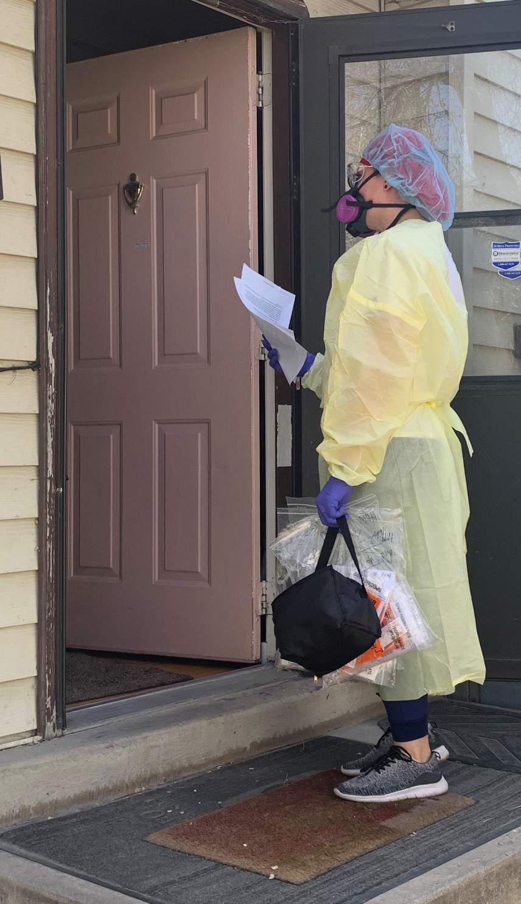
Highlight - UtahOne: PIs Adam Spivak, MD & Rachel Hess, MD
University of Utah and Intermountain leadership, on behalf of all of Utah
Utah TIC/DCC Study Design and Trial Implementation
Decentralized/in-home clinical research visits during the Pandemic
Notes:
Grant year 1 Average 37% (highest 44%)
Grant year 2 Average 35% (highest 44%)
Grant year 3 Average 41% (highest 62% with five months >48%)
Grant year 4 (March 2021 – 45%)
Additionally have trained new staff, including new scheduler role.

Slide 22
Highlight – Trial Innovation Network Toolbox
Public facing content (no log in required)
Under TIN Toolbox –
SIRB training, developed at Utah IRB and Utah TIC (Ann.Johnson@hsc.Utah.edu, Jeri.Burr@hsc.Utah.edu)
RIC COVID Recruitment Kit (Developed by our partners at the Duke/Vanderbilt Recruitment Innovation Center)
Notes:
Grant year 1 Average 37% (highest 44%)
Grant year 2 Average 35% (highest 44%)
Grant year 3 Average 41% (highest 62% with five months >48%)
Grant year 4 (March 2021 – 45%)
Additionally have trained new staff, including new scheduler role.

Slide 23
Highlight – AVOCA Consortium membership
Clinical trial resources: anyone with an hsc.Utah.edu email can join (email me at Dixie.Thompson@hsc.Utah.edu)
Utah TIC Jeri.Burr@hsc.Utah.edu; Maryse.Brulotte@hsc.Utah.edu
Avoca Knowledge Center AKC contains industry tools and leading practices like:
Member case studies
Research reports and data
Recorded webinars
ICH E6 (R2) Compliance Landscape Map
Protocol Development Leading Practices and Quality Check in
Notes:
Grant year 1 Average 37% (highest 44%)
Grant year 2 Average 35% (highest 44%)
Grant year 3 Average 41% (highest 62% with five months >48%)
Grant year 4 (March 2021 – 45%)
Additionally have trained new staff, including new scheduler role.

Slide 24
In closing… Masks, Vaccines, Asymptomatic & Symptomatic Testing
Notes:
Grant year 1 Average 37% (highest 44%)
Grant year 2 Average 35% (highest 44%)
Grant year 3 Average 41% (highest 62% with five months >48%)
Grant year 4 (March 2021 – 45%)
Additionally have trained new staff, including new scheduler role.

