Slide 1
Center for Clinical and Translational Science
Alison Santiago, MSW, MJ (she/her)
Senior Regulatory Specialist
University of Illinois at Chicago, Center for Clinical and Translational Science

Slide 2
History/Background
CIRTification: Community Involvement in Research Training
Developed by Emily E Anderson, PhD, MPH
Significant input from the community
Originated as an in-person training
Facilitator manual, workbook, and power points
English and Spanish material
Continued demand = online version
More accessible

Slide 3
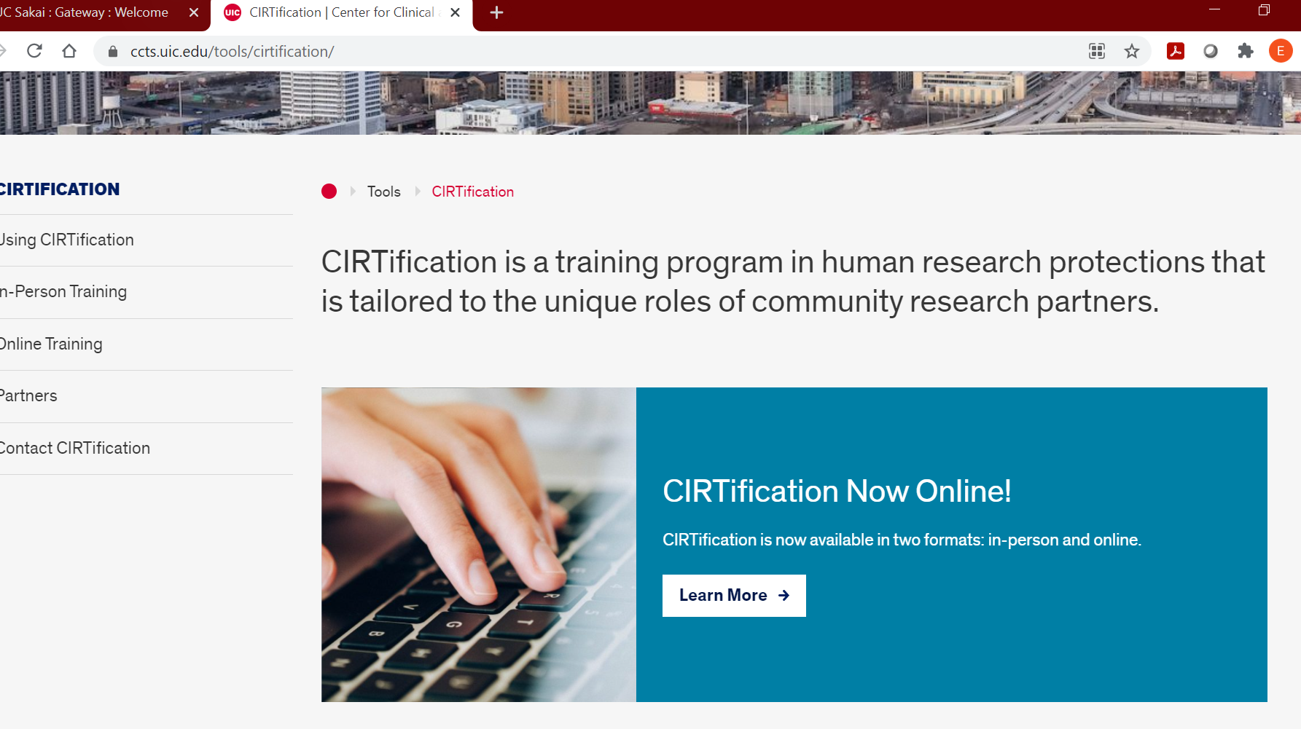
The Program & Purpose

Slide 4
Key Features of CIRTification Online
Free! Available to anyone who wants to complete the training
Available in English, Spanish, and Haitian Creole
Audio throughout
Interactive elements, videos, and case scenarios
Tailored for the background/roles of community research partners
Includes a dictionary of research terms and a toolbox with resources
Can be completed in multiple sessions
Date-stamped certificate of completion

Slide 5
Institutions Using CIRTification
CTSA funded institutions/Hub partners
Albert Einstein College of Medicine/Montefiore Medical Center
Case Western Reserve University
Duke University
Georgetown University
George Washington University
Indiana University/Purdue University/Notre Dame
Morehouse School of Medicine
Northwestern University
Ohio State University
Penn State University
Rush University
Rutgers, The State University of New Jersey
State University of New York at Buffalo
University of California San Francisco
University of Cincinnati
University of Colorado Denver
University of Wisconsin – Madison
Virginia Commonwealth University
Yale University
University of Illinois at Chicago (UIC)
University of Kansas Medical Center
University of Kentucky
University of Maryland Baltimore County
University of Massachusetts Chan Medical School Worcester
University of Miami School of Medicine
University of Nebraska Lincoln University of Pittsburgh
University of Puerto Rico/Ponce Medical School Foundation
University of Rochester
University of Utah
University of Virginia
OTHER INSTITUTIONS
Alliance Chicago
Campbell University
Chitracing Project, UIC School of Public Health
Girls in the Game
Howard Brown
Jewish Theological Seminary
Lorain County Community College
Louisville Presbyterian Theological Seminary
Massachusetts Institute of Technology
Ottawa Hospital Research Institute
The Fenway Institute
Trillium Health
UIC Citizen Scientist Program
University of Illinois, Urbana-Champaign
University of Liverpool
As of December 2022

Slide 6
CIRTification Modules

Slide 8
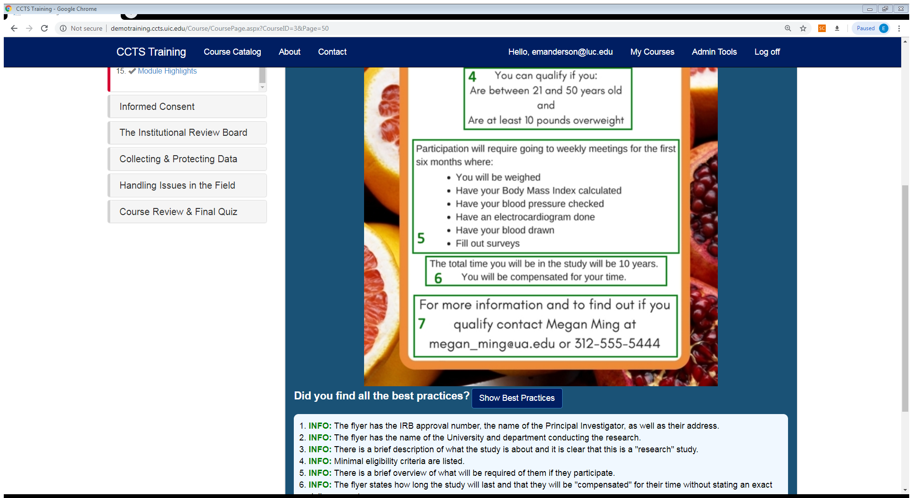

Slide 16
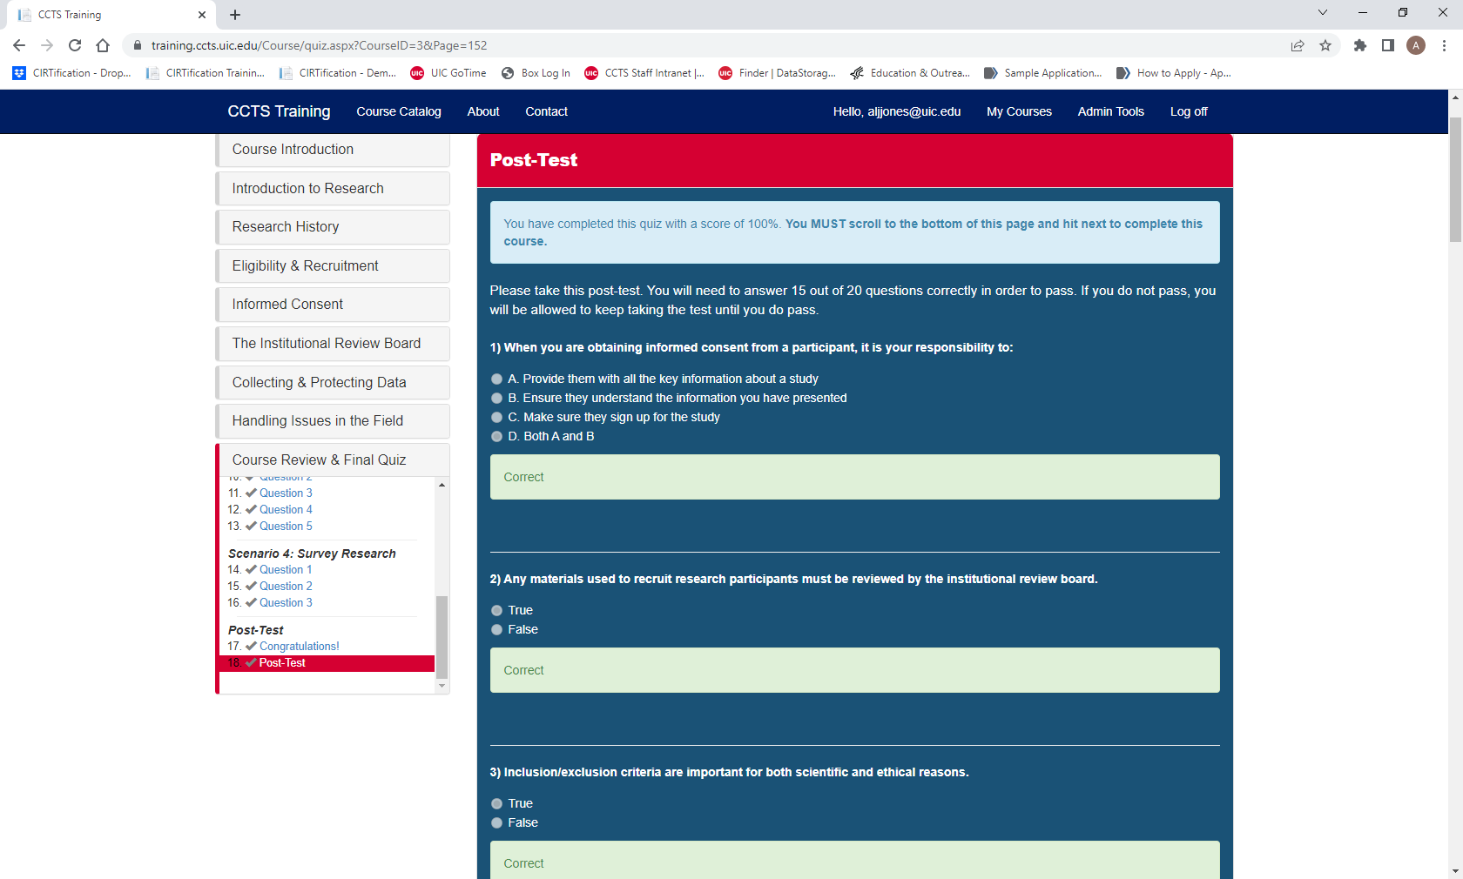

Slide 17
Certificate of Completion
Learners complete a knowledge quiz at the end of the program and receive a date-stamped certificate of completion

Slide 18
Future Plans
“Refresher” version/continuing training
Evaluation data – and research on impact
Post program discussion guide
Offer more languages

Slide 19
Email Us!
cirtification@uic.edu
Alison Santiago, MSW, MJ (she/her)
Email: aljjones@uic.edu

